Slide 1
MEMORY UNIT
INTRODUCTION
In this unit we shall discuss about various types of memory associated with a computer system including main memory, cache and virtual memory and various technology associated with these
memory units. Finally, we conclude the unit discussing the concept of secondary memory along with their types.
MR. SOLOMON ANAB

Slide 2
MEMORY HIERARCHY
The computer stores the programs and the data in its memory unit.
The CPU fetches the instructions out of the memory unit to execute
and process them.
Memory can be primary (or main) memory and secondary (or auxiliary)
memory. Main memory stores programs and data currently executed
by the CPU of a computer. Auxiliary memory provides backup storage
of information. Data as well as instructions are transferred from the
secondary memory to the main memory whenever it is needed by
the CPU.
MR. SOLOMON ANAB

Slide 3
The capacity of the memory is typically expressed in terms of bytes
or words (1 byte = 8 bits). Word lengths are commonly 8 bits, 16
bits and 32 bits. The size of a word is generally the number of bits
that are transferred at a time between the main memory and the
CPU.
Memory has different locations, which are called its addresses, to
store the data. There are different methods for accessing those
address locations such as sequential access, direct access and
random access.
MR. SOLOMON ANAB

Slide 4
• In Sequential access method, the records or the data are accessed in a linear fashion, from its current location in the memory to the desired location moving through each and every record in the memory unit. For example , in case of the magnetic
tapes this method is used.
• In Direct Access, each record has different addresses based on the physical location of the memory and the shared Read/Write head moves directly to the desired record. This method is used in magnetic disks.
• In Random access each location can be randomly selected
and accessed directly. Main memory can be randomly accessed.
MR. SOLOMON ANAB

Slide 5
MEMORY OPERATION
Memory has two basic operations: Read and Write operations. In
Read operation, the processor reads data from a particular memory
location and transmits that data to the requesting device via bus. On
the other hand, a memory Write operation causes the memory to
accept data from a bus and to write that particular information in a
memory location.
MR. SOLOMON ANAB

Slide 6
SPEED OF THE MEMORY
Regarding the speed of the memory, there are two useful measures
of the speed of memory units : Memory Access Time and Memory
Cycle Time.
Memory Access Time is the time between the initiation of a memory
operation and the completion of that operation. Memory Cycle Time
is the minimum time delay that is required between the initiation of
two successive memory operations, for example between two
successive memory read operations.
MR. SOLOMON ANAB

Slide 7
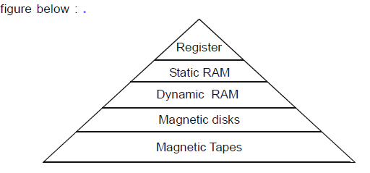
The computer system has a memory hierarchy consisting of the
storage devices in it. A typical memory hierarchy is illustrated in the figure below:
MR. SOLOMON ANAB
Memory Hierarchy

Slide 8
CHARACTERISTICS OF THE MEMORY
There are three key characteristics of the memory. They are cost,
capacity and access time. On moving down the memory hierarchy,
it is found that the cost of the storage devices decreases but their
storage capacity as well as the memory access time increases. In
other words, the smaller memories are more expensive and much
faster. These are supplemented by the larger, cheaper and slower
storage devices.
MR. SOLOMON ANAB

Slide 9
Thus from the above figure it can be seen that the registers are at
the top of the hierarchy and so provides the fastest, the smallest and
the most expensive type of memory device for the CPU to access
data. Registers are actually small amount of storage available on the
CPU and their contents can be accessed more quickly than any
other available storage. They may be 8–bit registers or 32-bit registers
according to the number of bits that they can hold in them.
Magnetic disks and Magnetic Tapes are the secondary storage
mediums whose data holding capacities are much larger than the
Processor Registers and the semiconductor memories which cannot
hold all the data to be stored in the computer system.
MR. SOLOMON ANAB

Slide 10
MAIN MEMORY
The main memory is the central storage unit of the computer system.
Main memory refers to the physical memory which is internal to a
computer. The word “Memory” when used usually refers to the Main
Memory of the computer system. The computer can process only those data which are inside the main memory. For execution, the
programs and the data must be first brought into the main memory
from the storage device where they are stored. Computer memory
has a crucial role in the performance, reliability and the stability of the
system.
MR. SOLOMON ANAB

Slide 11
TYPES OF MAIN MEMORY
There are two types of main memory:
• RAM (Random Access Memory) and
• ROM (Read Only Memory).
RAM : In RAM, it is possible to both read and write data from and
to the memory in a fixed amount of time independent of the memory
location or address.
ROM : ROM is a non-volatile semiconductor memory; that is, it doesn’t
lose its contents even when the power is switched off. ROM is not
re-writable once it has been written or manufactured. ROM is used
for programs such as bootstrap program that starts a computer and
load its operating system.
MR. SOLOMON ANAB

Slide 12
SEMICONDUCTOR RAM
The basic building block of the semiconductor memories is the RAM
chip. RAM is actually made up of a number of RAM chips. They
contain a number of memory cells, which are electronic circuits having
two stable states : 0 and 1. The binary information are stored in the
form of arrays having rows and columns in the memories. With the
advent and advances of VLSI (Very Large Scale Integration) circuits,
thousands of memory cells can be placed in one chip.
MR. SOLOMON ANAB

Slide 13
Static and Dynamic RAM
There are two main types of semiconductor RAM Memories :
Static RAM (SRAM) and Dynamic RAM (DRAM) and also their variations.
Static RAM consists of internal flip-flops to store the binary
information. Each flip-flop has four to six transistors in them.
SRAM can hold its data as long as the power is supplied to the
circuit. Also SRAM cells can keep the data intact without any
external refresh circuitry.
Static RAM is so called as they can retain their state as long
as the power is applied. As SRAM never has to be refreshed,
it is very fast. However, because it requires several transistors,
it takes up more space on a RAM chip than the Dynamic RAM
cells.
MR. SOLOMON ANAB

Slide 14
performance-wise SRAM is superior
to the DRAM. But because of the size and cost of the SRAMs,
DRAM is used for the system memory or main memory instead
and SRAM are used for Cache memory as cache memory
needs to be more faster and small.
MR. SOLOMON ANAB

Slide 15
Dynamic RAM are so named because their cells do not retain their states indefinitely. DRAM stores the information in the
form of a charge on capacitors. The capacitor holds a charge
if the bit is a “1” and holds no charge if the bit is a “0”. Unlike
SRAM, DRAM uses only one transistor to read the contents of
the capacitor. The capacitors are very tiny and can hold a
charge only for a short period of time, after which it starts
fading away. Therefore a refresh circuitry is required in case of
DRAM cells to read the contents of the cell and to refresh them
with a fresh charge before the contents are lost.
This refreshing of the cells are done hundreds of time in every second
irrespective of whether the computer is using the DRAM memory
at that time or not.
MR. SOLOMON ANAB

Slide 16
DRAM can again be Synchronous DRAM and Asynchronous
DRAM. The DRAM discussed above is Asynchronous DRAM, that is, the memory is not synchronized to the system clock.
The memory signals are not at all coordinated with the system clock.
The Synchronous DRAM or SDRAM is synchronized with the
system clock; that is, it is synchronized with the clock speed
of the microprocessor. All signals are according to the clocks
so the timings are controlled and tight. The figure below shows
the structure of SDRAM.
MR. SOLOMON ANAB

Slide 17
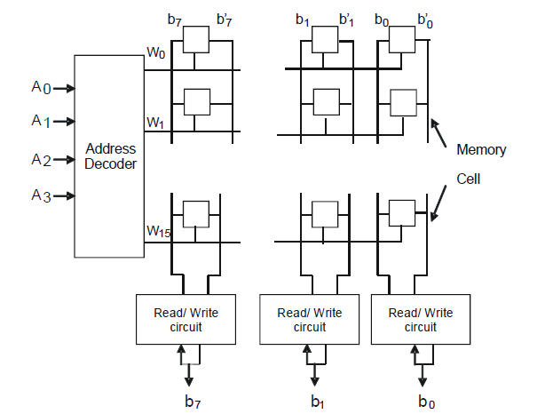
Internal Organization of Memory Chips
Internally, the memory in the computer system is organized in the form of array of rows and columns.
MR. SOLOMON ANAB
Organization of cells in a memory chip

Slide 18
Each cell in the array can hold one bit of information. Each row in the array forms a memory word. The cells in the column are all connected to
a Read/Write circuit. The figure above presents a possible
organization of the memory cells.
Let us consider a simple example of the organization of a 64-
bit memory. If the memory is organized into 16 groups or words,
then it can be arranged as 16 x 4 memory, that is, it contains
16 memory words and each of the word is 4 bits long. There
are also other ways of organizing the same memory, like for
example, it can be arranged as 64 x 1, 32 x 2 or 8 x 8.
MR. SOLOMON ANAB

Slide 19
CHECK YOUR PROGRESS
1. Compare the characteristics of SRAM and DRAM.
2. Fill in the blanks :
(a) Data and _____ are transferred from the secondary
memory to the _______ whenever it is needed by the CPU.
(b) The records or the data are accessed in a linear fashion,
from its current location in the memory in _________ access.
(c) Memory _______time is the time between the initiation of a
memory operation and the completion of that operation.
(d) Memory ________ time is the minimum time delay that is
required between the initiation of two successive memory
operations.
(e) Memory access time is _________ in Magnetic disks than
in magnetic tapes.
(f) Registers are small storage inside the ___________.
(g) RAM can access data in a fixed amount of time _______
of the memory location or address.
(h) RAM is a ______ memory and ROM is a _______memory.
(i) Registers are measured by the number of _____ that they
can hold.
(j) The magnetic tapes are more suited for the __________ of
the large amounts of the computer data.
MR. SOLOMON ANAB

Slide 20
ROM
ROM (Read Only Memory) is another type of main memory that can
only be read. Each memory cell in ROM is hardware preprogrammed
during the IC (Integrated Circuit) fabrication process. That is the code
or the data in ROM is programmed in it at the time of its manufacture.
The data stored in ROM is not lost even if the power is switched off.
For this reason, it is called a non-volatile storage. It is used to store
programs that are permanently stored and are not subject to change.
The system BIOS program is stored in ROM so that the computer
can use it to boot the system when the computer is switched on.
MR. SOLOMON ANAB

Slide 21
Types of ROM
There are five types of ROM :
1. ROM (Read Only Memory)
2. PROM (Programmable Read Only Memory)
3. EPROM (Erasable Programmable Read Only Memory)
4. EEPROM (Electrically Erasable Programmable Read Only Memory)
5. Flash EEPROM Memory
MR. SOLOMON ANAB

Slide 22
1. ROM (Read Only Memory)
The contents of ROM are permanent and is programmed at
the factory. It is designed to perform a specific function and
cannot be changed. It is reliable.
2. PROM (Programmable Read Only Memory)
As the name indicates, this type of ROM chips allows the user
to code data into it. However, PROMs can be programmed only once. They are more fragile than ROMs.
3. EPROM (Erasable Programmable Read Only Memory)
An EPROM is another type of ROM chip that allows data to be
erased and reprogrammed. They can be rewritten many times.
MR. SOLOMON ANAB

Slide 23
4. EEPROM (Electrically Erasable Programmable Read Only Memory)
The drawbacks of EPROMs are that they must be physically removed to be rewritten and also the entire chip has to be completely erased to just change a particular portion of it. EEPROM was introduced to remove these drawbacks of EPROM. EEPROM chips can be both programmed and the contents can be erased electrically.
5. Flash EEPROM Memory
As EEPROM is slow to be used in products that have to make quick changes to the data on the chip, so the Flash EEPROM devices were developed.
The advantage is that they work faster and the power consumption is low.
MR. SOLOMON ANAB

Slide 24
CHECK YOUR PROGRESS
3. Write True or False :
(a) SRAM and DRAM are the two types of semiconductor
memories.
(b) SRAM stores the data in flip-flops and DRAM stores the data
in capacitors.
(c) Main memory is actually the Static RAM.
(d) DRAM is more expensive as compared to SRAM.
(e) The capacitors have their own tendency to leak their charge.
(f) Conventional DRAM is the Synchronous DRAM.
4. Fill in the blanks :
(a) A refresh circuitry is required in case of ___________.
(b) SRAM are used for _______________ memory and DRAM is
used for ______________ memory
(c) DRAM uses one transistor to read the contents of
the______________________.
(d) The type of RAM that can hold its data without external
refresh for as long as power is supplied to the circuit is called
_________________.
(e) SDRAM is synchronized to the ____________________.
(f)_________________ is rapidly becoming the new memory
standard for modern PC’s.
MR. SOLOMON ANAB

Slide 25
LOCALITY OF REFERENCE
During program execution, memory access time is of utmost importance. It has been observed that data and instructions which are executed repeatedly are located near to each other. Many instructions in localized areas of the program are executed repeatedly
during some time period and the other remaining instructions of the program are accessed relatively infrequently. This characteristic of the program is referred to as the “locality of reference”. There are two types of locality of references. These are : temporal locality and spatial locality.
MR. SOLOMON ANAB

Slide 26
Temporal locality of reference means that a recently executed instruction is likely to be executed again very soon. This is so because when a program loop is executed the same set of instructions are referenced and fetched repeatedly. For example, loop indices, single data element etc.
Spatial locality of reference means that data and instructions which are close to each other are likely to be executed soon.
This is so because, in a program, the instructions are stored in consecutive memory locations. For example, sequential code, array processing, code within a loop etc.
MR. SOLOMON ANAB

Slide 27
CACHE MEMORY
To make use of the locality of reference principle, a small high-speed memory can be used to hold just the active portions of code or data. This memory is termed as cache memory. The word cache is pronounced as cash. It stores data and instructions which
are to be immediately executed. Two types of caching are commonly found in computers. These are : memory caching and disk caching.
MR. SOLOMON ANAB

Slide 28
Memory Caching
In case of memory caching, the cache is made up of high-speed static RAM (SRAM). Static RAM is made up of transistors that do not need to be constantly refreshed. It is much faster than the dynamic RAM; access time is about 10 nanoseconds(ns). The main memory is usually made up of dynamic RAM(DRAM) chip. It is directly addressed by the CPU and its access time is about 50 ns. Data
and instructions stored in cache memory are transferred to the CPU many times faster as compared to main memory.
By using an intelligent algorithm, a cache contains the data that is accessed most often between a slower peripheral device and the faster processor.
MR. SOLOMON ANAB

Slide 29
Some memory caches are built into the architecture of microprocessors. These are called internal cache. For example, the Intel 80486 microprocessor contains a 8K memory cache and the Pentium has a 16K cache. Such internal caches are often called Level 1(L1) caches. Cache outside the microprocessor i.e., on the motherboard is called external cache or Level 2(L2) cache. External caches are found in almost all modern personal computers. These caches are placed between the CPU and the DRAM. Like L1 caches, L2 caches are composed of SRAM but they are much larger.
MR. SOLOMON ANAB

Slide 30
Disk Caching
Disk caching works under the same principle as memory caching, but instead of using high-speed static RAM, it uses dynamic RAM.
The most recently accessed data from disk is stored in the main memory which is made up of DRAM. When a program needs to access data from the disk, it first checks the disk cache to see if the data is there. Disk caching can improve the performance of
applications, because accessing a byte of data in DRAM can be thousands times faster than accessing a byte on a hard disk.
MR. SOLOMON ANAB

Slide 31
Cache Operation - an overview
When the CPU sends an address of instruction code or data, the cache controller examines whether the content of the specified address is present in the cache memory. If the requested data or instruction code is found in the cache, the
cache controller enables the cache memory to send the specified data/instruction to the CPU. This is known as a ‘hit’. If it is not found in the cache memory, then it is said that a ‘miss’ has occurred and the cache controller enables the controller of the main memory to send the specified code or data from the main memory. The performance of cache memory is measured in terms of hit ratio. It is the ratio of number of hits divided by the total number of requests made. By adding number of hits and number of misses, the total request is calculated.
MR. SOLOMON ANAB

Slide 32
It is not necessary for the processor to know about the existence of cache. Processor simply issues READ and WRITE requests using addresses that refer to locations in the memory. Both the main memory and the cache are divided into equalize
units called blocks. The term block is usually used to refer to a set of contiguous address locations of some size.
In a READ operation, the main memory is not involved. When a READ request is received from the processor, the contents of a block of memory words containing the location specified are transferred into the cache, one word at a time.
Usually, the cache memory can store a reasonable number of blocks at any given time. The correspondence between the main memory blocks and those in the cache is specified by a mapping function. When the cache is full, it becomes necessary to
implement a replacement algorithm. The replacement algorithm decides which block should be moved out of the cache to make room for the new block.
MR. SOLOMON ANAB

Slide 33
Normally, the block that will be replaced is the one that will not be accessed or needed
Again for the longest time. Cache provides a timer to control this situation.
When the memory operation is a WRITE, there are two ways to proceed: write-through method and write-back method.
• Write-through method: In this method, the cache
location and the main memory location are updated
simultaneously.
• Write-back method: This method is to update only the cache location and to mark it as updated with an associated flag bit also known as dirty bit . Here, the update of main memory occurs only when the block containing this marked word is to be removed from the
cache to make room for a new block.
MR. SOLOMON ANAB

Slide 34
TECHNIQUES FOR MANAGING WRITE OPERATIONS ON CACHES?
One common technique is to use a write-through cache, which means that every write operation is immediately written to both the cache and the main memory. This can help to ensure that data is not lost in the event of a power failure or other interruption. Another technique is to use a write-back cache, which only writes data to the main memory when it is convenient or when the cache is full. This can improve performance, but it carries the risk of data loss if the cache is not properly flushed before an interruption.
MR. SOLOMON ANAB

Slide 35
Different Cache Hit Ratios
There are four different cache hit ratios that can occur:
1. Compulsory Misses: These are misses that occur when a piece of data is accessed for the first time.
2. Capacity Misses: These misses occur when the cache is not large enough to hold all of the data that is being accessed.
3. Conflict Misses: These misses occur when two pieces of data are mapped to the same location in the cache.
4. Coherence Misses: These misses occur when data is being accessed from multiple locations at the same time.
MR. SOLOMON ANAB

Slide 36
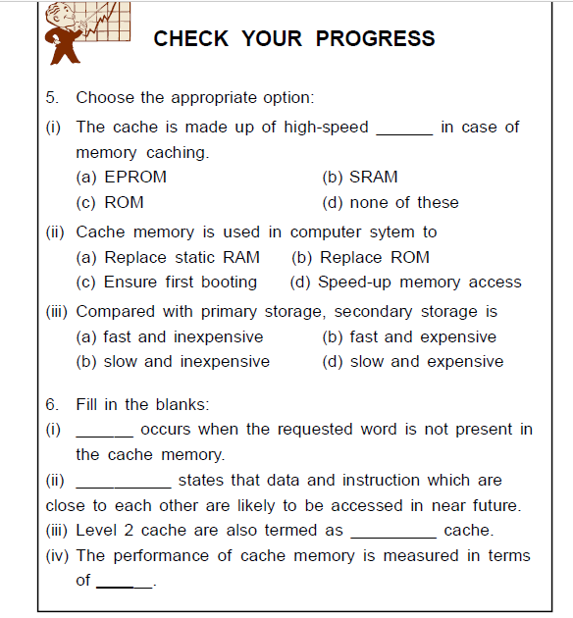
MR. SOLOMON ANAB

Slide 37
MAPPING FUNCTIONS
To search for a word in the cache memory, cache is mapped to the main memory. There are three different ways that this mapping can generally be done. These are:
• Direct Mapping
• Associative Mapping
•Set-Associative Mapping
Mapping functions are used as a way to decide which main memory block occupies which line of cache. As there are less lines (or block) of cache than main memory blocks, an algorithm is needed to decide this. Let us take an example, a system with a cache of 2048 (2K) words and 64K (65536) words of the main memory. Each block of the cache memory is of size 16 words. Thus, there will be 128 such blocks (i.e., 16*128 = 2048). Let the main memory is addressable by 16 bit address (i.e., 216 = 65536 = 64*1024).
MR. SOLOMON ANAB

Slide 38
Direct Mapping
The simplest way for determining the cache location for placement of a main memory block is the direct mapping technique. Here, the block i of the main memory maps onto block i modulo 128 of the cache memory.
The advantage of direct mapping is that it is simple and inexpensive. The main disadvantage of this mapping is that there is a fixed cache location for any given block in main memory. If a program accesses two blocks that map to the
same cache line repeatedly, then cache misses are very high.
MR. SOLOMON ANAB

Slide 39
Associative Mapping
This type of mapping overcomes the disadvantage of direct mapping by permitting each main memory block to be loaded into any line of cache. To do so, the cache controller interprets a memory address as a tag and a word field. The tag uniquely identifies a block in main memory.
With this mapping, the space in the cache can be used more efficiently. The primary disadvantage of this method is that to find out whether a particular block is in cache, all cache lines would have to be examined. Using this method, replacement algorithms are required to maximize its potential.
MR. SOLOMON ANAB

Slide 40
Set-Associative Mapping
Set-associative mapping combines the best of direct and associative cache mapping techniques. In this mapping, cache memory blocks are grouped into sets. It allows a
block of the main memory to reside in any block of a specific set. Thus, the contention problem which usually arise in direct mapping can be avoided by having a few choices for
placement of block.
MR. SOLOMON ANAB

Slide 41
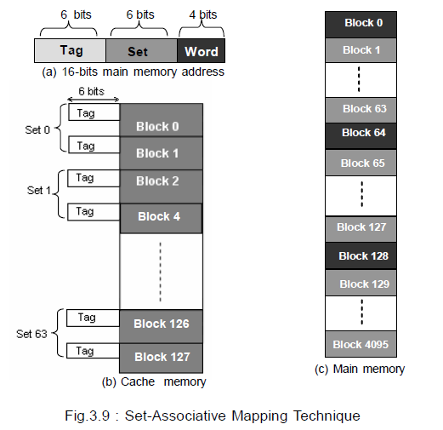
MR. SOLOMON ANAB

Slide 42
In the figure below, set-associative mapping technique is shown. Here, the cache is divided into sets where each set contains 2 cache blocks. Thus, there will be 64 sets in the cache of 2048(2K) words.
Each memory address is assigned a set, and can be cached in any one of those 2 locations within the set that it is assigned to. In other words, within each set the cache is associative, and thus the name set associative mapping.
MR. SOLOMON ANAB

Slide 43
REPLACEMENT ALGORITHMS
For direct mapping where there is only one possible line for a block of memory, no replacement algorithm is required. For associative and set associative mapping, however, an algorithm is needed. At this point, we will describe the one most common replacement algorithm, called LRU algorithm.
This algorithm is easy to understand and provides a good background to understand the more advanced replacement algorithms. Several other replacement algorithms are also used in practice such as: first in first out replacement algorithm, random replacement algorithm etc.
MR. SOLOMON ANAB

Slide 44
Least Recently Used (LRU) : Due to locality of reference, programs usually stay in localized areas for reasonable period of time. So there is a high probability that the blocks that have been referenced recently will be referenced again soon. Therefore, it
overwrites block in cache memory that has been there the longest with no reference to it. That block is known as the least recently used block and the technique is known as least recently used (LRU) replacement algorithm.
In this method, a counter is associated with each page in the main memory and it is incremented by 1 at fixed intervals of time. When a page is referenced, its counter is set to 0. Thus, counter gives the age of a page. When a page needs to
be removed, the page with the highest counter is removed.
MR. SOLOMON ANAB

Slide 45
VIRTUAL MEMORY
Before coming to the point virtual memory, let us review some basics: physical memory(RAM) versus secondary memory(disk space).
Computers these days typically have somewhere between 128 megabytes (128 million bytes) and 4 gigabytes (4 billion bytes) of main memory (RAM). What is important is that when we turn the computer off or if it crashes - anything stored in RAM is gone. That is why when we are editing a document it is a better to save to disk
often. When we talk about disks, we are talking about the hard disk
MR. SOLOMON ANAB

Slide 46
address of main memory. In such a case, an address generated by the CPU is called virtual address or logical address. A set of such addresses is called the address space. Virtual addresses might be the same as physical addresses. Physical address refers to the address of a location of the main(physical) memory. A set of physical
addresses is termed as memory space. If virtual and physical addresses are different, then virtual addresses must be mapped into physical addresses and this mapping is done by Memory Management Unit (MMU).
MR. SOLOMON ANAB

Slide 47
Paging
Paging is a method for achieving virtual memory. It is the most common memory management technique. Here, the virtual address space and memory space are broken up into several equal sized groups. To facilitate copying the virtual memory into the main memory, the operating system divides virtual address space into fixed size pages. Physical address space(memory space) is also broken up into fixed size page frames.
MR. SOLOMON ANAB

Slide 48
Page in virtual address space fits into frame in physical memory. Each page is stored on a secondary storage (hard disk) until it is needed. When the page is needed, the operating system copies it from disk to main memory(RAM), translating the virtual addresses into physical addresses.
This process of copying the virtual pages from disk to main memory is known
as paging.
MR. SOLOMON ANAB

Slide 49
MAGNETIC DISKS
A magnetic disk is a circular plate which is constructed of metal or plastic coated with a magnetizable material on which electronic data are stored. Data can be stored on both sides of the disk. Several disks can be stacked on top of the other on a spindle. These disks are actually rotating platters with a mechanical arm that moves a read/write head between the inner and outer edges of the disks surface. A read/write head is available on each of the disk surface. A magnetic disk works on the principle of
magnetic charge. The disks rotates at very high speeds. During a read/ write operation, only the disk rotates and the head is always stationary.
MR. SOLOMON ANAB

Slide 50
Data Organization in Magnetic Disk
Data on the magnetic disks is organized in a concentric set of circles, called tracks. The bits of data are stored as magnetic spots in these tracks. A gap exist between each track to prevent errors due to interference of magnetic fields. The number of
bits stored in each track is equal. Therefore, the data density is more in the inner tracks than the outer ones. The more the number of tracks, the more is the storage capacity of the disk.
MR. SOLOMON ANAB

Slide 51
Tracks are again divided into sections called sectors. A small gap also exists between two sectors so as to distinguish between them. Each sector usually contains 512 bytes of data. The set of corresponding tracks on all surfaces of a stack of disks forms a logical cylinder. The disk platters rotates together at a very high speed.
MR. SOLOMON ANAB

Slide 52
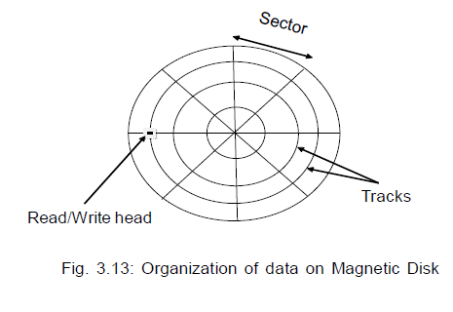
MR. SOLOMON ANAB

Slide 53
A write head is used to record the data bits as magnetic spots on the tracks and these recorded bits are detected by a change in the magnetic field produced by a recorded magnetic spot, on the disk surface, as it passes through a read head. The data on the disk surfaces are accessed by specifying the surface number, track number and sector number.
Some magnetic disk uses a single read/ write head for each disk surface while others uses separate read/ write heads for each track on the disk surface. Accordingly, the read/write head may be movable or fixed.
MR. SOLOMON ANAB

Slide 54
Now a days, Winchester technology is used where both the disks and the read/write heads are placed in sealed enclosures.
This technology has two advantages.
First, in such disk units, the heads operates closer to the tracks as there are no dust particles, as in disk units which are not sealed. As such data can be more densely stored along the tracks and the tracks can also be closer to one another. These Winchester disk units has a larger capacity for storing data.
Secondly, in these disk units, the data integrity is more as they are not exposed to contaminating elements.
MR. SOLOMON ANAB

Slide 55
KEY PARTS OF THE DISK
The disk system consists of three key parts.
First is the stack of disk platters, usually referred to as the disk.
Second is the electromechanical mechanism that rotates the
disk and moves the read/write heads, which is called the disk drive.
Third is the disk controller, which controls the disk system operation. It also provides an interface between the disk drive and the bus that connects it to the computer system.
MR. SOLOMON ANAB

Slide 56
Disk Access Time
To perform a read or a write operation, the read/write head is first positioned on the desired track and sector. In fixed-head systems the head over the desired track is selected electronically. In a movable head system, the head is positioned
on that particular track. In such systems, the time that is taken to move the head to the proper track is called the seek time.
It depends on the initial position of the head relative to the track specified in the address.
MR. SOLOMON ANAB

Slide 57
In either case, after the read/write head is positioned over the track, the system waits until the appropriate sector passes under the read/write head. This delay in time is called the rotational delay or latency time.
The sum of these two delays, that is the seek time and the latency time is called the disk access time.
The storage capacity of a disk is a multiple of the number of tracks per surface, number of sector per track, and the number of bytes per sector.
MR. SOLOMON ANAB

Slide 58
That is,
Storage capacity of a disk system = Number of recording surfaces
x Number of tracks per surfaces
x Number of sector per track
x Number of bytes per sector
The following Fig. shows a typical disk pack. Always remember that- the upper surface of the top plate, and the lower surface of the bottom plate are not used for information storing.
MR. SOLOMON ANAB

Slide 59
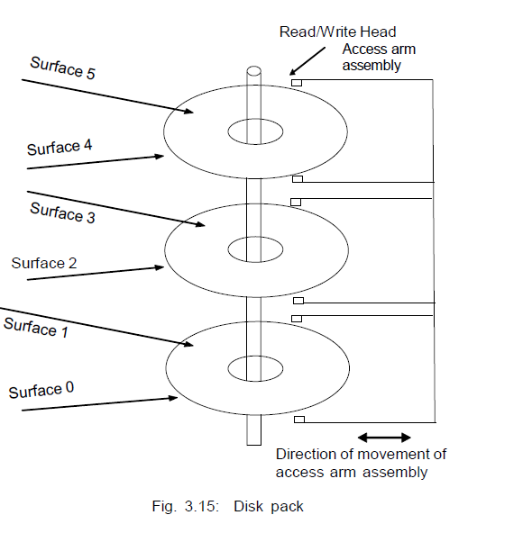
MR. SOLOMON ANAB

Slide 60
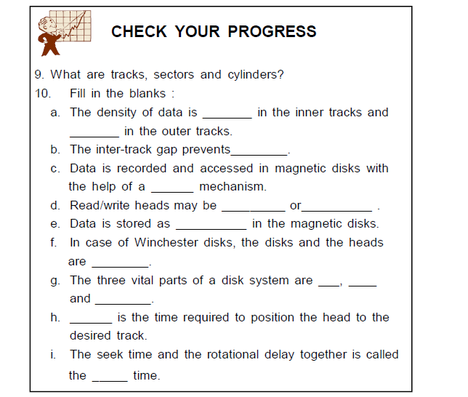
MR. SOLOMON ANAB

Slide 61
RAID
The rate in the increase in the speeds of the processor and the main memory is much more than that in the improvement of the secondary storage devices. Of course there has been an increase in the storage capacities of these devices.
However, it was been recognized that high performance could be achieved at a reasonable cost by using multiple low-cost devices to operate in parallel. This lead to the use of arrays of disks that operate independently and in parallel.
MR. SOLOMON ANAB

Slide 62
In 1988, researchers at the University of California-Berkeley proposed
a multiple disk storage system, called RAID (Redundant Array of Inexpensive Disks). There were six different configurations, which were known as the RAID levels - RAID 0, RAID 1, RAID 2, RAID 3, RAID 4 and RAID 5. All of these six levels share three common characteristics.
They are -
MR. SOLOMON ANAB

Slide 63
1. RAID is a set of physical disk drives which operates as one logical drive.
2. The data is distributed across the physical drives of an array.
3. In case of a disk failure, the data can be recovered as identical data is stored on more than one disk in the set of the disks.
MR. SOLOMON ANAB

Slide 64
In RAID 0, data stripping is used. This means a single file is stored in several separate disks by breaking the file into a number of smaller pieces. Whenever a file is read, all the disks delivers their stored portion of the file in parallel. So the total transfer time of the file is equal to the transfer time that would be required in case of a single disk system divided by the number of disks used in the array.
MR. SOLOMON ANAB

Slide 65
In the RAID 1 scheme identical copies of the same data are stored on two disks. Data stripping is also used here but the strip is mapped to both the physical disks. The two disks are mirrors of each other.
If a disk failure occurs, then all the operations on its data can be done on its mirror disk. The disadvantage of RAID 1 scheme is the cost involved with it to improve the reliability.
MR. SOLOMON ANAB

Slide 66
RAID 2, RAID 3, RAID 4 and RAID 5 in all these schemes some parity calculations are done so as to achieve reliability and recover the errors. The data are not fully duplicated RAID 2 requires fewer disks but is still costly. RAID 5 distributes the parity strips across all disks.
RAID offers excellent performance and are generally used in high performance computers or in systems where higher degree of data reliability is required.
MR. SOLOMON ANAB

Slide 67
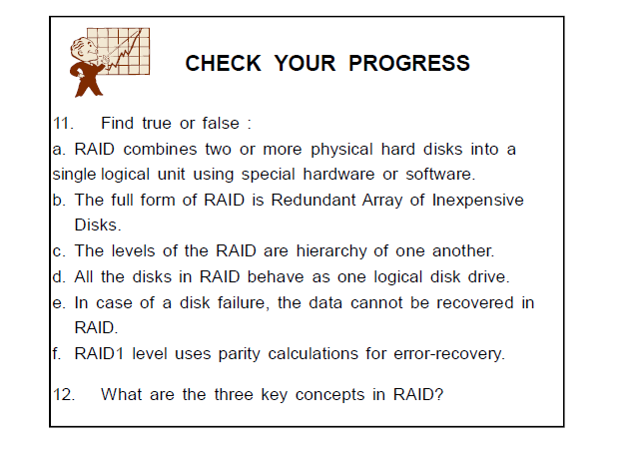
MR. SOLOMON ANAB

Slide 68
OPTICAL MEMORY
In optical memory, the data is stored on an optical medium like CDROM.
The stored data can then be read with the help of a laser beam. Large amounts of data can be stored in optical memory at a very reasonable cost. The audio CD (Compact Disk) were the first application of such technology.
In the mid 1980’s Sony and Philips companies developed the first generation of CDs. The CDs are non-volatile and they could not be erased.
MR. SOLOMON ANAB

Slide 69
In the past few years a variety of optical disk systems have been introduced:
CD (Compact Disk)
CD-ROM (Compact Disk Read Only Memory )
WORM (Write Once Read Many)
Erasable Optical Disk, etc.
MR. SOLOMON ANAB

Slide 70
CD-ROM
CD-ROM disk is a shiny, silver color metal disk usually of 51/4-inch (12cm) diameter. It is made of polycarbonate plastic and thin layer of pure aluminum is applied to make the surface reflective. For some good quality disks, gold layer is used. A thin layer of lacquer protects it. The surface of an optical disk consists of pits and land. The information is read from pits and lands, like 1s and 0s. It is changed into binary so computers can read it. An optical reader reads the patterns of pits that stands for bytes. One CD can hold 650MB of data or 300,000
pages of text. Most CDs are read only, which means you cannot save data to the disk. This device is usually not used as a primary storage device for data.
MR. SOLOMON ANAB

Slide 71
An optical disk is mounted on an optical disk drive for reading/writing of information on it. An optical disk drive contains all the mechanical, electrical and electronic components for holding an optical disk and for reading/writing of information on it. That is, it contains the tray on which the disk is kept, read/write laser beams assembly, and the motor to rotate the disk. Access
time for optical disks are in the range of 100 to 300 milliseconds.
MR. SOLOMON ANAB

Slide 72
Advantages of CD-ROM are -
a) Storage capacity is much more in optical disks.
b) Multiple copies of the disk along with its contents can be made inexpensively.
c) They are transportable from one computer to another very easily.
MR. SOLOMON ANAB

Slide 73
Disadvantages of CD-ROM are -
a) They are read-only and contents cannot be changed or updated.
b) The access time in optical disks is more than in case of magnetic disks.
MR. SOLOMON ANAB

Slide 74
DVD Disks
The success of CD technology and the continuing quest for greater storage capability has led to the development of DVD. DVD, also known as Digital Versatile Disk or Digital Video Disk, is an optical disk storage media format, and was invented and developed by Sony, and Philips in 1995.
Its main uses are video and data storage. DVDs are of the same dimensions
as compact disks (CDs), but store more than six times as much data.
MR. SOLOMON ANAB

Slide 75
Variations of the term DVD often indicate the way data is stored on the disks : DVD-ROM (read only memory) has data that can only be read and not written; DVD-R and DVD+R (recordable) can record data only once, and then function as a DVD-ROM; DVD-RW (re-writable), DVD+RW, and DVD-RAM (random access memory) can all record and erase data multiple times. The wavelength used by standard DVD lasers is 650 nm thus, the light has a red color.
MR. SOLOMON ANAB

Slide 76
The physical format of a DVD determines the capacity of the DVD disk. DVD capacity is determined by pit size, track pit spacing and the number of
layers the disk contains. In the following some list of disks (current) and their capacities are given :
MR. SOLOMON ANAB

Slide 77
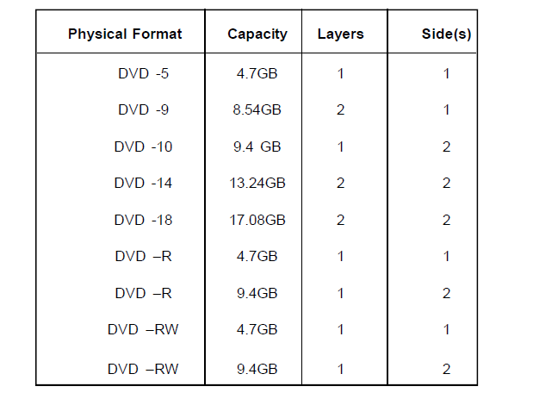
MR. SOLOMON ANAB

Slide 78
MAGNETIC TAPE
The magnetic tape is mostly used for off-line storage of large amount of data. They are the cheapest and the slowest methods for data storage.
The magnetic tape is a strip of plastic coated with a magnetic film.
The tape is very small and generally is of 0.5 or 0.25 inch wide. The data recording on the magnetic tape is same as in the case of magnetic disks. There are a number of parallel tracks on the tape.
Seven or nine bits corresponding to one character are recorded simultaneously with a parity bit.
MR. SOLOMON ANAB

Slide 79
Earlier the tapes had nine tracks each but the newer tape systems use 18 or 36 tracks, corresponding to a word or a double word. A separate read/write head is mounted one in each track so that data can be recorded and read in a sequential manner. Data are organized in the form of records and these records are
separated by gaps referred to as inter-record gaps.
MR. SOLOMON ANAB

Slide 80
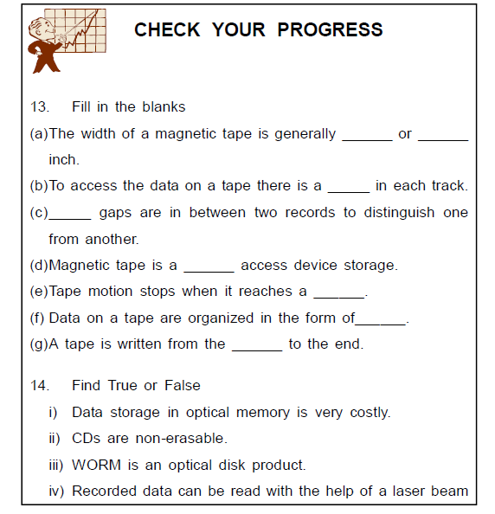
MR. SOLOMON ANAB

Slide 81
LET US SUM UP
The memory hierarchy in the computer system consists of the storage devices employed in the system with the faster but smaller devices at the top and the slow but high capacity and larger memory devices at the bottom.
Main memory holds the programs and data currently executed by the processor.
Main memory is of two types: Random Access Memory (RAM) and Read Only Memory (ROM).
RAM is a volatile memory; that is, the data and programs in
RAM are lost when the power is switched off whereas ROM is non-volatile memory; so it doesn’t lose its contents when power is turned off.
RAM may be Static RAM (SRAM) and Dynamic RAM (DRAM). SRAM is simple and has more speed than DRAM. But it is larger and costlier than DRAM.
MR. SOLOMON ANAB

Slide 82
Main memory is actually DRAM. SRAM is used in Cache memory.
ROM is a non-volatile memory that can only be read and not written. ROM is used in certain functions in the computer because of its data permanency and data security as the data cannot be modified easily. There are 5 types of ROM such as ROM, PROM, EPROM, EEPROM and Flash EEPROM.
The cache is a small amount of high-speed memory. Compared to the size of main memory, cache is relatively small. It operates at or near the speed of the processor. Cache memory contains copies of sections of the main the memory and is very expensive compared to the main memory.
MR. SOLOMON ANAB

Slide 83
Caches exploit the property of locality which states that applications tend to re-use data which they have recently used. This is seen in two forms: temporal locality and spatial locality.
Mapping is a technique for determining where main memory blocks can be placed in the cache. There are three different mapping techniques: direct mapping, associative mapping and set-associative mapping.
In direct mapping, one block from main memory maps into only one possible line of cache memory. As there are more blocks of main memory than there are lines of cache, many blocks in main memory can map to the same line in cache memory.
MR. SOLOMON ANAB

Slide 84
Associative cache mapping is the most complex, but it is most flexible with regards to where data-can reside. A newly read block of main memory can be placed anywhere in an associative cache. If the cache is full, a replacement algorithm is used to determine which block in the cache gets replaced by the new data.
Set-associative mapping is designed to utilize the strengths of the previous two mappings. As with a direct mapped cache, blocks of main memory data will still map into as specific set, but they can now be in any N-cache block frames within each set. Here, The cache is divided into a number of sets containing an equal number of lines. Each block in the main memory maps into one set in cache memory similar to that of direct mapping. Within the set, the cache acts as associative mapping where a block can occupy any line within that set. Replacement algorithms may be used within the set.
MR. SOLOMON ANAB

Slide 85
Virtual Memory is simply the operating system using some amount of disk space as if it were real memory.
Paging is a method of achieving virtual memory. Virtual space is broken up into equal size pages and memory space is broken up into equal size page frames.
The magnetic disk is divided into tracks, sectors and cylinders where the data are recorded.
There may be a single read/write head for each disk surface or separate heads for each track in the surfaces. Accordingly, heads may be movable or fixed.
Magnetic disk systems consists of three vital parts- the disk, disk drive and the disk controller.
MR. SOLOMON ANAB

Slide 86
RAID combines two or more physical disk units and behave as a single disk unit.
The three important concepts in RAID are - mirroring, striping and parity.
Optical memory stores data on an optical medium and the data is read using laser beams and photo detector.
MR. SOLOMON ANAB

